Slide 1
ORGRAY CAR RENTAL APPLICATION
Group Name
13269 – Innova Cloud
Group Members
Shiva Sai Kumar Chunduri 700754515
Rahul Solleti 700756485
Sony Harshitha Avula 700759101
Rithika Dundigalla 700757951

Slide 2
Introduction
Amazon VPC
Subnets, Route Tables, IGW
IAM Role and DB Subnet Groups
Relational Database Service (RDS)
Security Groups
Elastic Beanstalk
Application Deployment in EBS
CloudWatch
Challenges during the Project
Learning from the project
Agenda

Slide 3
Introduction
As a part of our project, we designed a car rental application and deployed it.
This application contains multiple pages: Log-in, Home, Check-In, Upload Car, Edit Car Details, Check-Out, and Check-Out Summary pages.
To deploy the application on AWS Cloud, we used the following AWS services Amazon VPC, Amazon Elastic Cloud Compute(EC2), Amazon RDS, IAM, Elastic Beanstalk, and Cloud Watch.

Slide 4
Amazon Virtual Private Cloud(Amazon VPC)
In the project, the VPC serves as a virtual network, facilitating a secure and segmented AWS environment.
It includes six subnets across two availability zones—two public and four private.
VPC components, such as public and private route tables, internet gateways, and subnet associations, ensure proper network isolation.
The VPC enables connectivity, security, and resource organization for the entire application infrastructure

Slide 5
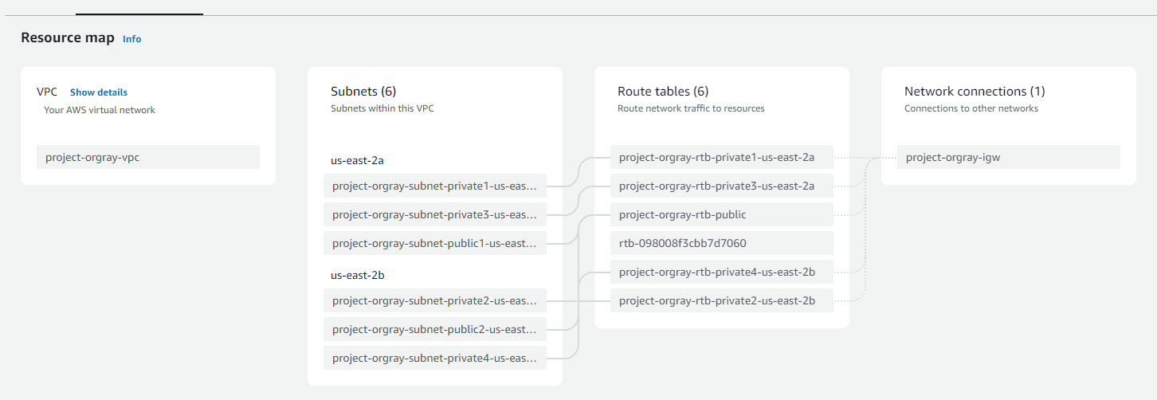
Subnets, Route Tables, and Internet Gateways(IGW)

Slide 6
IAM Role and DB Subnet Groups
In the project, we created an IAM role called aws-elasticbeanstalk-ec2-role with the following policies
AWSElasticBeanstalkWebTier
AWSElasticBeanstalkWorkerTier
AWSElasticBeanStalkMulticontainerDocker
DB subnet groups in RDS enhance security by isolating databases in private subnets, ensuring fault tolerance with at least three subnets.
This configuration optimizes network performance, supports scalability, and is crucial for maintaining high availability and data integrity in database operations.

Slide 7
Relational Database Service (RDS)
In this project, we created RDS instance called db-orgray with PostgreSQL as the database engine by using a DB subnet group which is mentioned in previous slide.
PostgreSQL handles concurrent transactions effectively, ensuring that multiple users can rent or return cars simultaneously without compromising data consistency.
Cars data and customer data are stored in DB. The size of DB is 5Gib

Slide 8
Security Groups
We created a security group called orgray-ebc-ec2-sg to manage the incoming and outgoing traffic in the instance.
We added an inbound and outbound rule with type as HTTP on port 80 to allow HTTP access to and from any IPv4 and IP6 address.
Moreover, we added another inbound and outbound rule with PostgresSQL on port 5432 to reduce the exposure to security risks and protect the PostgreSQL database server instances.

Slide 9
Elastic Bean Stalk (EBS)
Leveraged AWS Elastic Beanstalk to effortlessly deploy the Django application, streamlining the deployment process and auto-scaling as needed.
Simply upload your application, and Elastic Beanstalk automatically handles the details of capacity provisioning, load balancing, scaling, and application health monitoring.
In the project, we used Python as the Platform with Python 3.11 running on 64bit Amazon Linux 2023. We chose proxy server as Ngnix because it can handle a high volume of connections.

Slide 10
Application Deployment in Elastic Beanstalk
Utilized AWS Elastic Beanstalk Command Line Interface (EB CLI) in Visual Studio Code to deploy code seamlessly, storing it efficiently in Amazon S3.
Amazon S3, providing an efficient and scalable solution for version control and code management.
Initialize EB CLI in your Django project directory.
Generate a requirements.txt file for dependencies.
Execute `eb create` to deploy the Django app to Elastic Beanstalk.

Slide 11
CloudWatch
In this project, we used CloudWatch to create dashboards and added visualizations to it.
We created two dashboards:
orgray-ebs-dashboard to visualize environment and Instance Metrics
orgray-ec2-dashboard to visualize CPU and Network utilization.
We can choose the type of widget, configure the widget settings, or select different metrics based on our requirements.

Slide 12
Challenges Faced During the Project
Writing inbound and outbound rules for security groups.
Connecting PostgreSQL to application.
Configuring the environment which includes 5 stages to create Elastic Beanstalk application.
Setting up of awsebcli(elastic beanstalk command line interface) in visual studio code to handle dependencies, and ensuring smooth code deployment

Slide 13
Learning From the Project
AWS Infrastructure Configuration
Elastic Beanstalk Deployment
Database Management with RDS
Monitoring and Dashboards
VPC Networking & Security Measures
AWS CLI and Tool Integration
Database Subnet Groups
Application Version Control

Slide 14

Thank You..!! Any Questions ?

